Slide 1
Electrical Drives and Instrumentation Lab
Course Code:EEE-2422
Course Teacher: Mr. SAHARIAR REZA
Lecturer,IIUC,CSE

Slide 2
Team “Space-X” Members “B”
C193069 Shajibul Alam Shihab
C193044 Mohammad Ismail Emon
C193052 Fahim Chowdhury Jisun

Slide 3
Bluetooth Robot Car
Experiment Name: Bluetooth Robot Car
Components: 1.Arduino UNO
2. HC-05 Bluetooth Module
3. Motors
4. Motors Driver

Slide 4
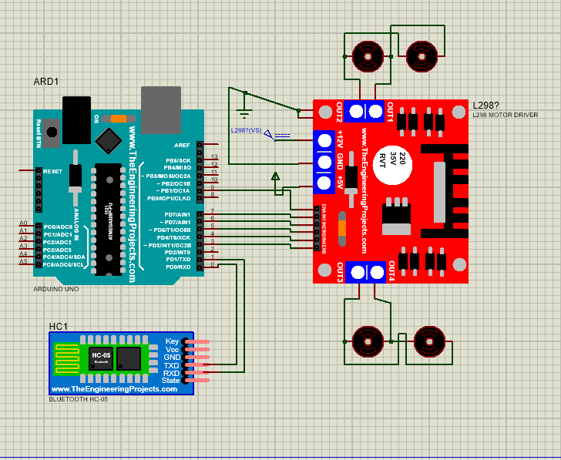
Circuit Diagram

Slide 5
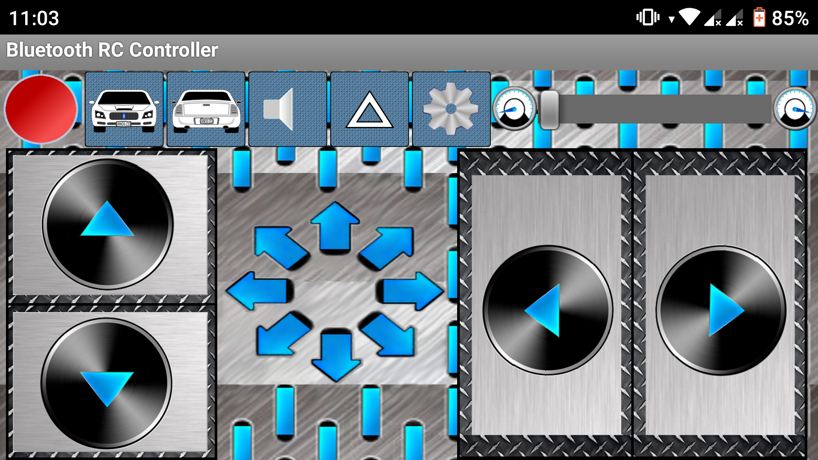
Controller
Speed control
Left
Right
Forward
Backward

Slide 6
Summary: I have made a robotic car that will move through Bluetooth. The movement will be according to the instructions given by the code. I will control it with the help of mobile.

Slide 7
Thank You From
Team
“Space-X”

